Slide 1

Supporting Discrete Caregiving Behaviors
Joseph E. Gaugler, PhD
University of Minnesota
June 23, 2025

Slide 2
Disclosures
EMBRACE AD/ADRD Roybal Center is supported by the National Institute on Aging of the National Institutes of Health under Award Number P30AG086642 (Gaugler & Gilmore-Bykovskyi)

Slide 3
Aims
Brief overview: The science of caregiving
Discrete behaviors, behavioral gerontology, and caregiving
AI applications/ideas

Slide 4
Rough Trajectory of Caregiving Science
1960s-1980s
  Identification of caregiving as an issue in gerontology
  Measurement of key caregiving concepts/outcomes (e.g., Lawton et al., 1989; Montgomery et al., 1985; Zarit et al., 1980)
1980s-1990s
  Theoretical refinement (e.g., Pearlin et al., 1990; Schulz, 1990)
  Intervention development and early evaluation
1990s-2000s
  Longitudinal research, emphasis on transitions (e.g., Aneshensel et al., 1995; Schulz & Beach, 1999; Schulz et al., 1997,2001)
  Syntheses of caregiving effects (e.g., Schulz et al., 1990, 1995; Schulz & Sherwood, 2008; Schulz & Martire, 2004; Vitaliano et al., 2003; Pinquart et al., 2003, 2005, 2006, 2007)
  More rigorous intervention design and evaluation (e.g., REACH/REACH II; NYUCI; RDAD; Gitlin protocols; Savvy Caregiver; Dementia Care Collaboration models; e.g., Schulz, 2000)
2000s-present
  Synthesis of racial and ethnic complexities in caregiving (e.g., Dilworth-Anderson et al., 2002)
  Meta-analyses of caregiving interventions and their effects
  Caregiving as a public health priority (Talley & Crews, 2007); nationally representative surveys of caregiving (HRS, NAC/AARP, etc.)
  Dissemination and implementation efforts of evidence-based interventions
  NAPA and reconsiderations of the state of dementia care science
  Ongoing incorporation of technology and caregiving: as measurement, intervention, etc.

Slide 5
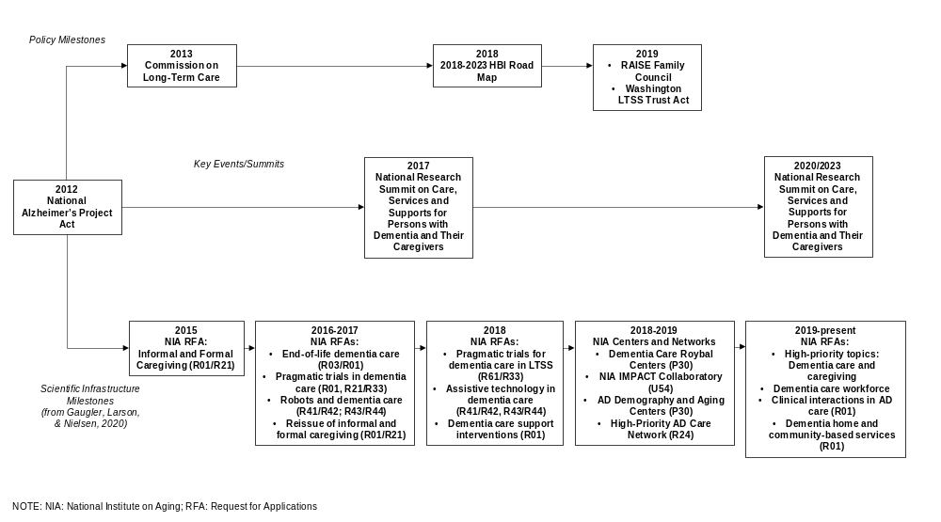
From Gaugler, 2022

Slide 6
Discrete Behaviors (ABA)
Simple presence or absence of an ability (van Hedger et al., 2020)
  Has a beginning and end
  Is observable
  Is measurable
  Distinct and separate from other behaviors
  In contrast to continuous behaviors

Slide 7
Application of ABA to Management of Behaviors in Dementia (from Agronin et al., 2014)
Behavior extends beyond the disease process: it is an interaction between the individual and the environment
Advantages in long-term care and, perhaps by extension, caregiving:
  Flexible and tailored treatment
  Using the “why” to influence intervention approaches
  May facilitate adaptive behaviors
Targets antecedents, consequences, and general setting
Staff/caregivers can view behavior as communication, to identify environmental triggers, and can take a more proactive approach

Slide 8
Behavioral Gerontology
“The study of how antecedent and consequent environmental events interact with the aging organism to produce behavior” (Burgio & Burgio, 1986, p. 321).
  Special issue in Journal of Applied Behavioral Gerontology published in 1986 (Iwata, 1986)
In a review from 2011, the Journal of Applied Behavioral Analysis only published 5 articles that focused on aging from 2006-2011 (Trahan et al., 2011)
  All five focused on the nursing home environment
  Four of five focused on people with dementia
Moore et al., 2007/Dixon et al., 2010 examples

Slide 9
Caregiving Examples
From Burgio and Kowalkowski (2011): "However, because of the field's assimilation by mainstream gerontology, relatively few contemporary practitioners of 'things behavioral' have received formal training in behavior analysis. Moreover, the language used to describe their activities might not always sound very 'behavioral.'" (p. 3)
Caregiving examples
  STAR Caregivers protocols (Teri and colleagues)
  REACH II
  Tailored Activity Program (Gitlin and colleagues)

Slide 10
Gaps in Behavioral Gerontology
(Trahan et al., 2011)
Generalization/maintenance of behavior change
  e.g., training for implementation
The need to broaden focus beyond behavior “problems”
Need to broaden context beyond the nursing home

Slide 11
Theoretical and Mechanistic Ramifications (from van Hedger et al., 2020)
Describing behaviors with accuracy when informing both theories and mechanisms that explain such behaviors
If a behavior is defined as discrete (i.e., present or absent), the underlying mechanisms must contribute to the behavior so that no variability is present
May also limit questions and how participants are described/included in research efforts

Slide 12
Possible AI Extensions
Identifying environmental patterns (antecedents and consequences) that result in discrete behaviors of caregivers and care recipients
  Develop a personalized tool/application that is specific to a caregiving context
  Extending and continuing work on remote activity monitoring technologies (e.g., Gaugler et al., 2019, 2021, 2022)

Slide 13
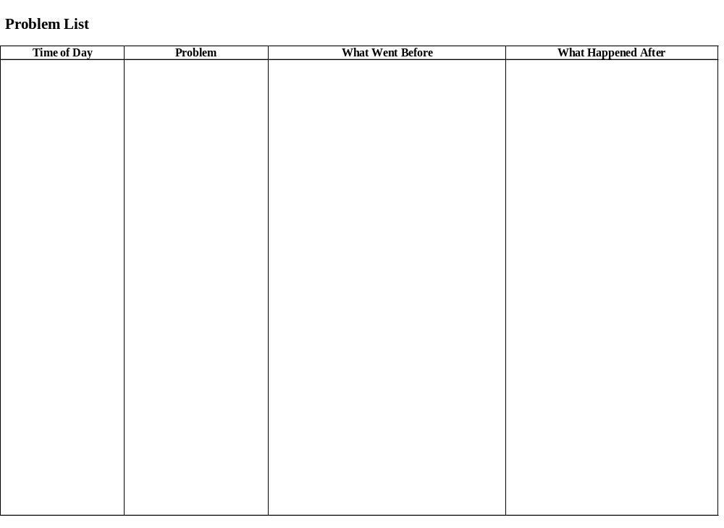
(Zarit, 2009, p. 127, Table 6.4)
Notes:
13

Slide 14
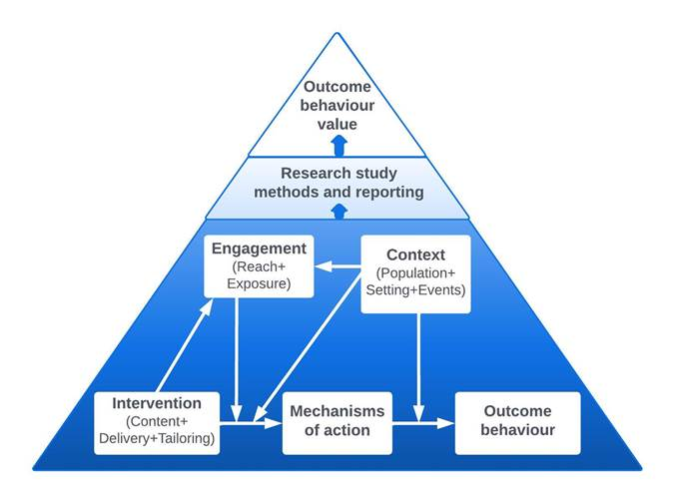
Other Possible AI Extensions
Ontological tools (Susan Michie, UCL: Behavior Change Intervention Ontology/BCIO)
  https://www.bciontology.org/
  See also https://www.nationalacademies.org/our-work/accelerating-social-and-behavioral-science-through-ontology-development-and-use

Slide 15
Q & A
Thank you!
Check out our website https://embraceroybal.wisc.edu
or
Contact: EMBRACE@umn.edu

